Slide 1
Citi Bike Data Analysis
Arnav Dashaputra
Assignment 3

Slide 2
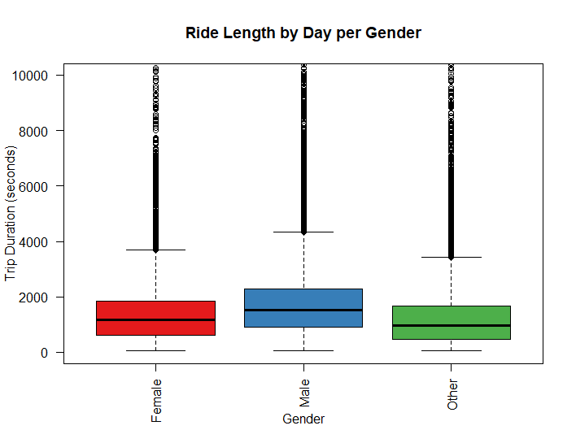
Ride Length by Day per Gender
This data reveals that on average, Males tend to take longer bike rides (not by length, but by time) than Female or other unspecified or unknown genders. Though subtle, this pattern is interesting especially due to the “unknown” column. One thing that this may show Citi is that they should be more aggressive in collecting gender data per bike, or have additional gender options for individuals to fit under. Additionally, bike seat types typically vary between male and females, just naturally due to their body proportions. If citi was to create distinct models for their bikes, with the user selected the one that fit them best, it may increase the ride time as more people would want to use citi bikes as their mode of transportation.
R code: boxplot(citi$tripduration~citi$gender,las=2, main="Ride Length by Day per Gender",ylim=c(0,10000), xlab="Gender", ylab="Trip Duration (seconds)", col = brewer.pal(4,"Set1"))

Slide 3
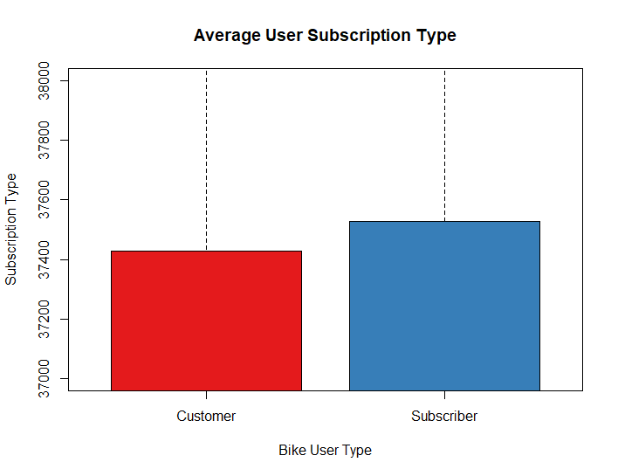
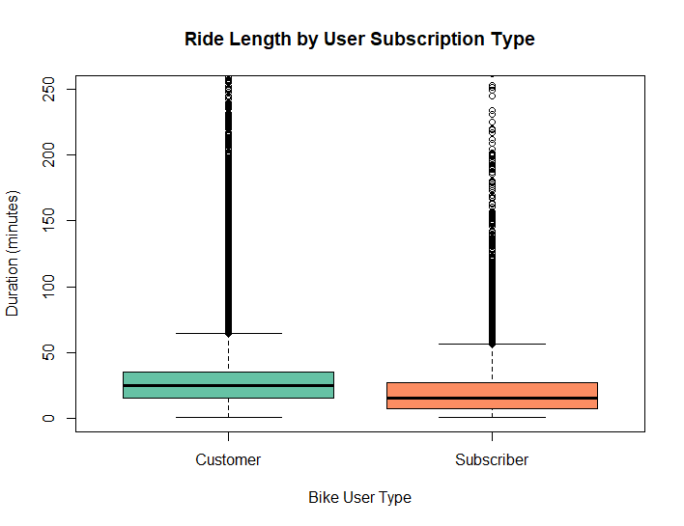
Ride Length by Day per Gender
This data shows that on average, subscribers tend to take shorter bike trips than average customers. Subscribers are individuals that pay a larger fee beforehand, to then save money overall with unlimited rides. Therefore, normal customers lose money if they do not have a subscription but are still taking out bikes regularly. Accordingly, there are more subscribers than regular customers, but the data is very close, just over 50% of users are subscribers.
The way that a citi bike pass works is that when you either buy a day pass or hold a subscriber pass, you can take as many rides as you want. The data shows that subscribers are making use of this - by taking shorter rides, it can be assumed that subscribers are using citi bikes over other modes of transportation, especially for short distances. Normal paying customers, on the other hand, are only take out passes for citi bikes when they need to make longer trips. However, since the data here is very close, it reveals how situational buying day passes are for individuals looking to use citi bikes.
R code: boxplot(citi$tripduration/60~(citi$usertype), ylim=c(0,250), xlab="Bike User Type", main="Ride Length by User Subscription Type", ylab="Duration (minutes)", col = brewer.pal(3,"Set2"))
boxplot(citi$X~(citi$usertype), ylim=c(37000,38000), xlab="Bike User Type", main="Average User Subscription Type", ylab="Subscription Type", col = brewer.pal(3,"Set1"))

